Slide 1
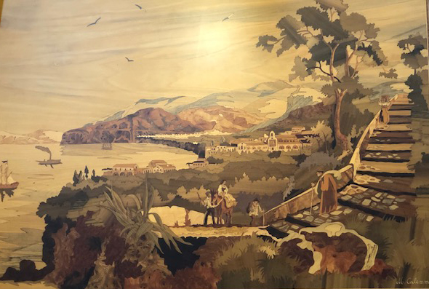
Marquetry in Sorrento

Slide 2
Introduction
On a recent trip to the Amalfi Coast, I discovered that Sorrento has long been a focal point for marquetry (intarsia) and parquetry in southern Italy.
It was very widely practiced, particularly in the late 1800’s.
Today, examples of marquetry can bee seen throughout the city. For example, the walls of the elevator in our hotel were all inlaid with marquetry pictures.
One afternoon I went exploring and found some unexpected pleasures.
The marquetry museum (Museobottega della Tarsialignea) was four stories of displays dating from the 1800’s to the present day.
Along the way I ran across an exhibit in a church. The work done by Michele Calemma and his father was exceptional.
My most unexpected encounter was with the three generations of the Salvatore family. Their workshop, where they use a scroll saw to cut by the pad method, was part of their store. The store itself was stacked high with boxes, pictures, coasters, and the like. All decorated with marquetry and finished with high gloss polyurethane.
If you ever get a chance to visit Sorrento, be sure to stop in and say hi to Salvatore as well as his father and son.

Slide 3
Museobottega della Tarsialignea www.museo-bottega-della-tarsia-lignea

Slide 4
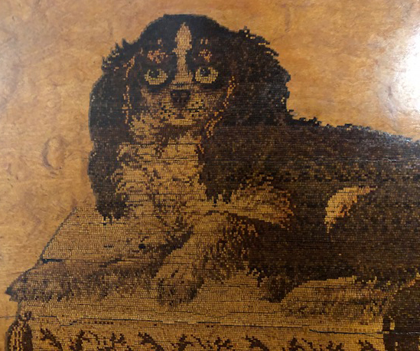
Museobottega della Tarsialignea

Slide 5
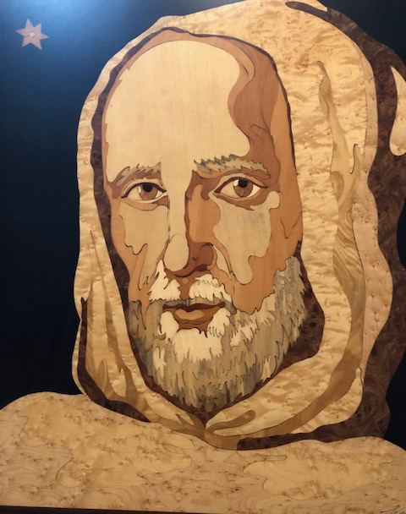
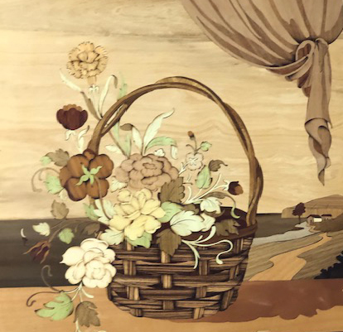
Michele Calemma www.calemmaintarsio.com

Slide 6
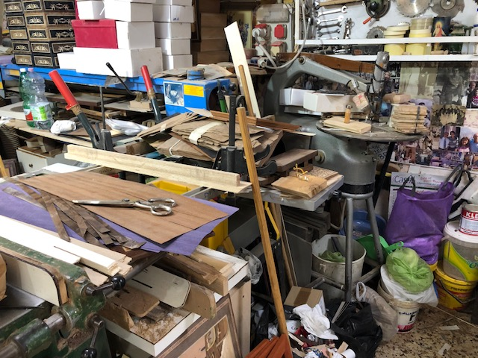
Gargiulo Salvatore gargiuloinlaid.it

Slide 7
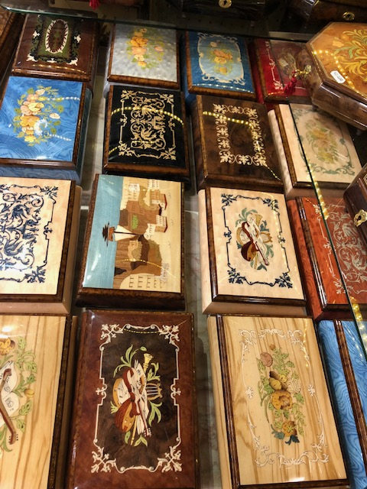
Gargiulo Salvatore www.gargiuloinlaid.it

Slide 8
Ciao Bella Sorrento

